Slide 1
Intrusion Detection using
Machine Learning
BY
SOURABH (2K18/CO/355) - Lab Group G1
TANYAM SINGHAL (2K18/CO/371) - Lab Group G2

Slide 2
What is Intrusion Detection
Intrusion detection is the process of monitoring and analyzing the events occurring in a computer system in order to detect signs of security problems.Empirical results show that selected reduced attributes give better performance to design IDS that is efficient and effective for network intrusion detection. We apply one of the efficient classifier naive bayes on reduced datasets for intrusion detection.

Slide 3
Different ways of classifying an IDS based on:
1. Anomaly detection: this ids based models the normal usage of the network as a noise characterization. anything distinct from the noise is assumed to be an intrusion activity. E.g., flooding a host with lots of packet. The primary strength is its ability to recognize novel attacks. 2. signature based ids: this ids possess an attacked description that can be matched to sensed attack manifestation. The question of what is relevant to an ids depends upon what t is trying to detect. E.g. DNS, FTP etc. 3. host based/application based ids: the host operating system or the application logs in the audit information. These audits information includes events like the use of identification and authentication mechanism(logins ect.)file open and program executions, admin activities etc. These audits then analyzed to detect trails of intrusion.

Slide 4
Different ways of classifying an IDS based on:
4.Network based: This ids looks for attack signatures in network signatures in network traffic via a promiscuous interface. a filter is usually applied to determine which traffic will be discarded or passed on to an attack recognition module. This helps to filter out known un-malicious traffic.
5.Stack based ids: they are integrated closely with the TCP/IP stack, allowing packets to be watched as they traverse their way up the OSI layer. This allows the ids to pull the packet from the OS or the application have a chance to process the packets.

Slide 5
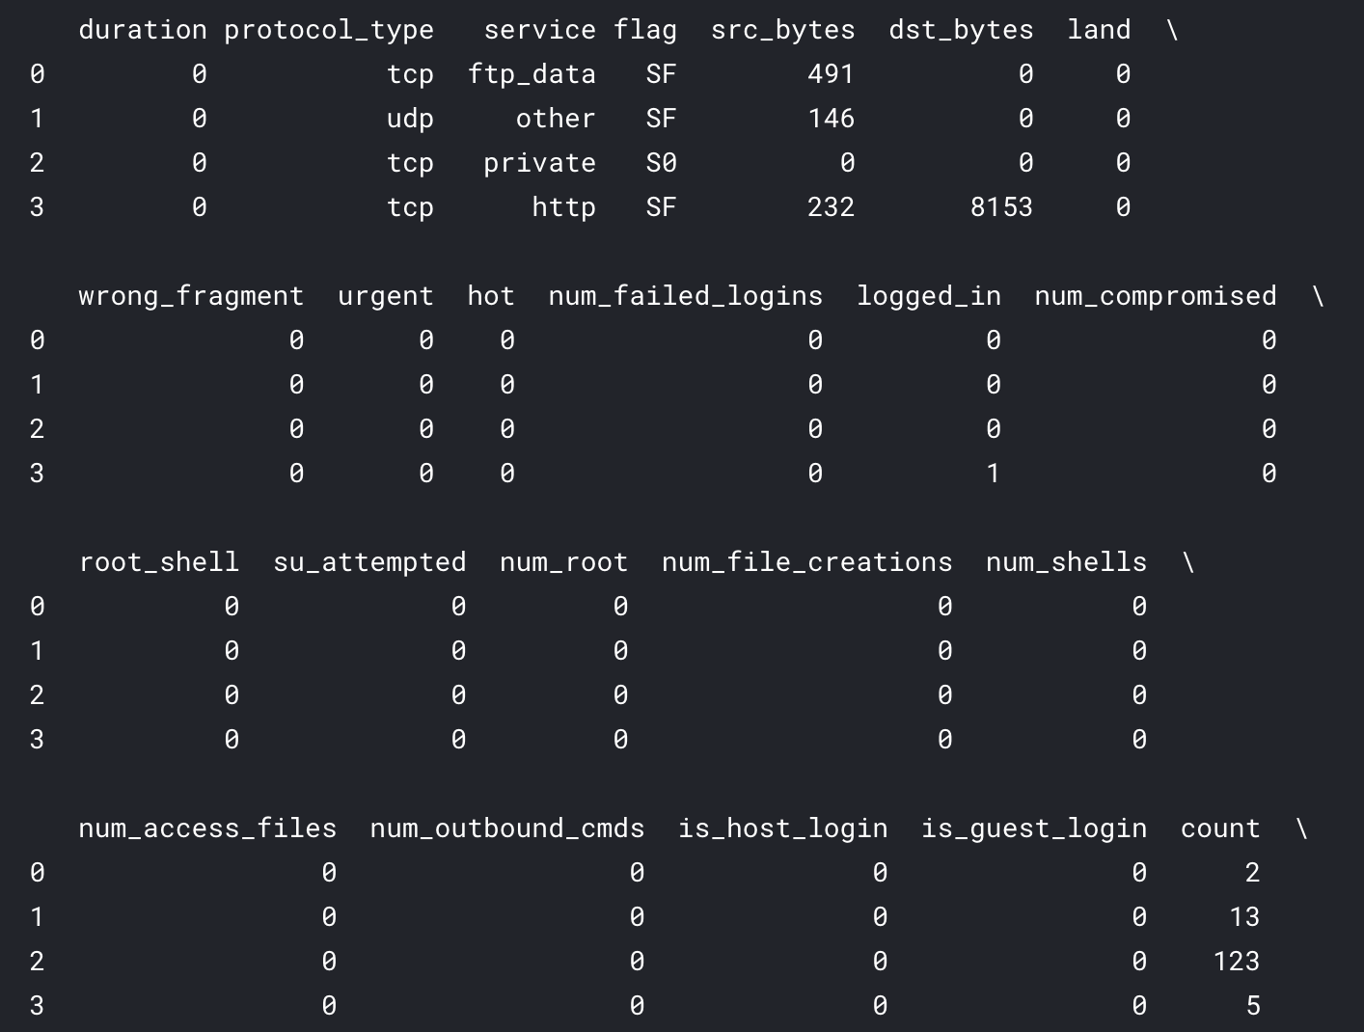
The Dataset

Slide 6
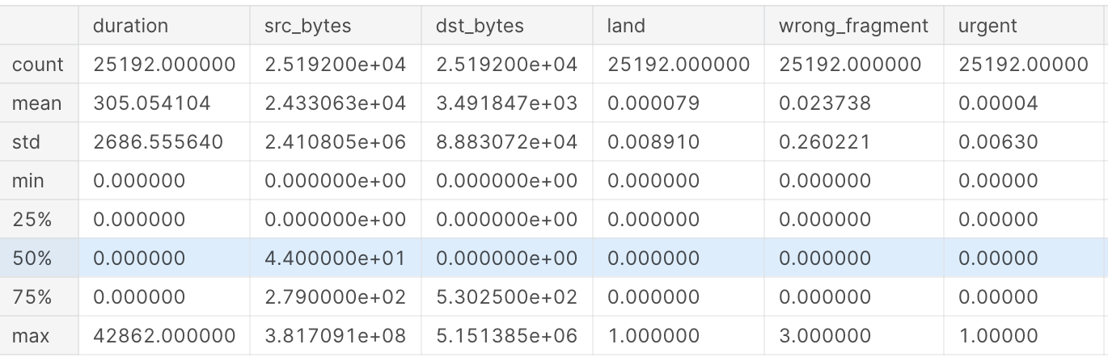
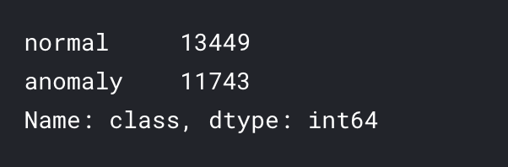
EXPLORATORY ANALYSIS

Slide 7
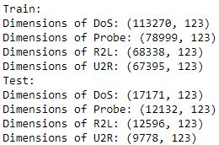
Split Dataset into 4 datasets for every attack category
(Rename every attack label: 0=normal, 1=DoS, 2=Probe, 3=R2L and 4=U2R)

Slide 8
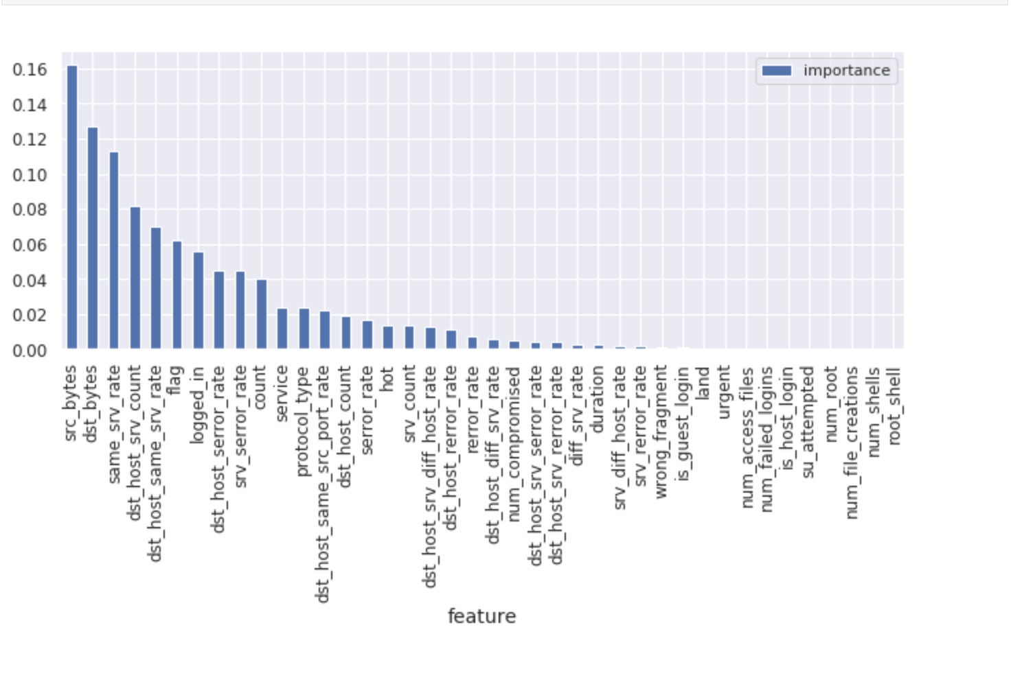
Feature Selection

Slide 9
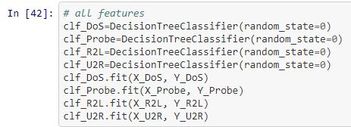
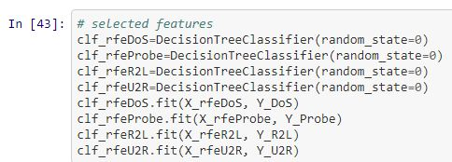
Building The Model

Slide 10
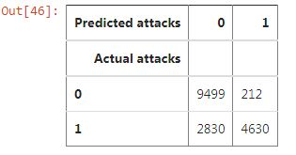

Prediction and Evaluation
1) DOS

Slide 11
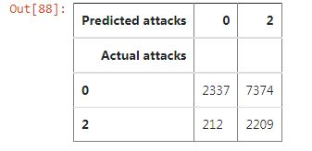

2) PROBE

Slide 12
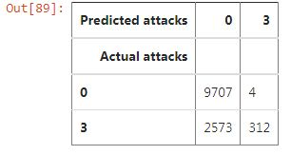

3) R2L

Slide 13
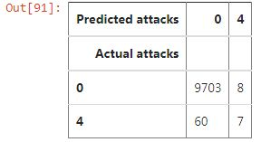

4) U2R

Slide 14
References
Kumar, M., Hanumanthappa, M., & Kumar, T. S. (2012, November). Intrusion Detection System using decision tree algorithm. In 2012 IEEE 14th international conference on communication technology (pp. 629-634). IEEE.
Rahman, C. M., Farid, D. M., Harbi, N., Bahri, E., & Rahman, M. Z. (2010). Attacks classification in adaptive intrusion detection using decision tree.
Sahu, S., & Mehtre, B. M. (2015, August). Network intrusion detection system using J48 Decision Tree. In 2015 International Conference on Advances in Computing, Communications and Informatics (ICACCI) (pp. 2023-2026). IEEE.

